Slide 1
Status of Current JTLS-GO Releases
Eric McDonald
Director of Development
JTLS-GO

Slide 2
- Development Team - Release Versioning - 6.3 Release Cadence - Release Support - Team Updates

Slide 3
JTLS-GO Development Team
Small, efficient group of 14
Core Model Development
Systems and Services
Database
Frontend / User Interface
Testing

Slide 4
JTLS-GO Development Team
Ellen Roland | Chief Model Engineer, Systems Design
Eric McDonald | Director, Frontend, Support Tools and Services, Systems Design
Dr. Donna Womble | Model Development, Entity Level Server, Federation Support
John Hertz | Model Development
Harold Yamauchi | Model Development, Support Tools and Services
Robert Ruks | Part Time Model Development
Rick Kalinyak | Part Time Senior Resource

Slide 5
JTLS-GO Development Team
Zafer Aktan | Database Schema Design and Administration
Dr. Steve Tang | Systems Backend, Security, Systems Design
Jane Wu | Database Frontend
Vance Southern | Data Repository and Scenario Development
Jose Torres | WHIP Frontend
Bill Lynn | Systems and Support Tools
Caspian Forsyth | Testing, Documentation, Senior Control

Slide 6
JTLS-GO Release Versioning

Slide 7
6.3.4.0
Flagship.Main.Minor.Patch

Slide 8
Flagship.Major.Minor.Patch (v6.3.4.0)
Flagship Release
Fundamental, underlying technology changes
JTLS-GO 5.0
Removed Hexagon Terrain – Used Grid Terrain
JTLS-GO 6.0
Simscript III
Moved to PostgreSQL from Oracle
Requires planning to adopt and understand changes
Possibly a few months
Includes database format changes
Conversion tool included
Breaking JDSP API changes

Slide 9
Flagship.Major.Minor.Patch (v6.3.4.0)
Major Version – major improvements, not backward compatible
Model and system Improvements
Likely requires database format changes
Conversion tool provided
Likely breaking JDSP API changes
Should plan on time for understanding model changes
Approximately a few weeks

Slide 10
Flagship.Major.Minor.Patch (v6.3.4.0)
Minor Version – backward compatible features and fixes
Quarterly maintenance releases of 3rd Party tools (Java, Postgres)
Configuration changes, code fixes, small improvements
No database format changes
No breaking JDSP API changes
No need to worry about linked software
Errors may have been fixed in the JDSP API
Make sure to read Chapter 1 of Version Description Document (VDD)
Adoption of Minor versions can be immediate
Recommendation to use the newest/best available

Slide 11
Flagship.Major.Minor.Patch (v6.3.4.0)
Patch Version – bug fix release, backward compatible
Solve immediate problem of specific user
Bring latest version to an exercise
Not an officially delivered release
Not all users notified
No formal VDD delivered
If an organization has an upcoming exercise:
Monitor rolands.com 0Readme (changelog)
Ask help desk for list of fixes since last Patch release
Simply Need To Ask For Interim Release To Support Exercise

Slide 12
Current Release Support

Slide 13
Current Release Support
Current Releases
JTLS-GO 6.2 – Expected EOL June 2025
JTLS-GO 6.3 – Current Release
JS/J7 Operations & Maintenance Task
Support ends 12 months after release of JTLS-GO 6.4
JTLS-GO 6.4 – Planned Future Release – June 2025

Slide 14
Team Updates

Slide 15
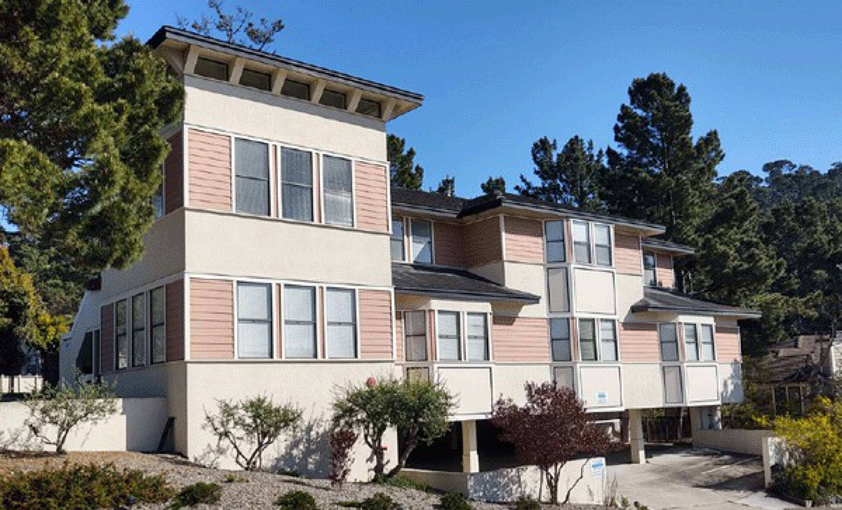
New Facility
Training Room Update
Virtualized machines
Thin clients at each station
More efficient management of versions
Easier to meet training needs
Instructors and trainees have remote access to the virtualized environment
🔗classroom.rolands.com

Slide 16
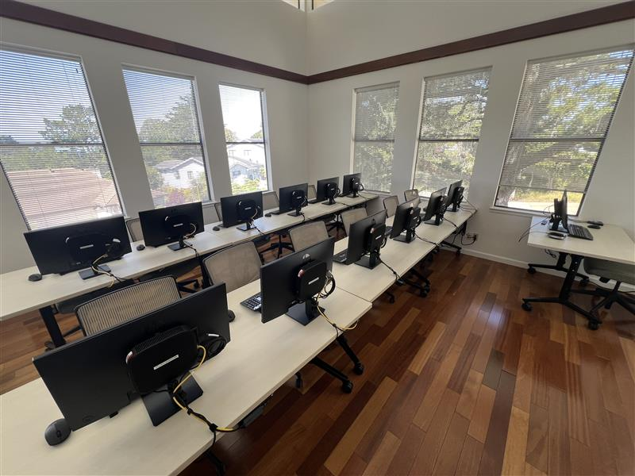
Virtualized Environment
Team moved to virtualized machine environment
Growing pains are beginning to ease
Simplified systems maintenance and access
Plans for tiered maintenance systems

Slide 17
Ticketing System
Detailed tracking and more transparent responses
Quicker notification of user communications
Collaborative management for the whole team
🔗jtlshelpdesk.valkyrie.com ✉️jtlsgo@valkyrie.com

Slide 18
Repository Realignment
EUROPE
7 Sides
43 Countries
Europe Terrain
Africa
5 Sides
54 Countries
Africa Terrain
Terrain Grids
Networks
OPFOR
Combat Systems
JTLS-GO REPOSITORY DATABASE
14 Sides
23 Countries (Factions)
Detailed Terrain for Korea
AMERICA
6 Sides
31 Countries
America Terrain
MENA
6 Sides
21 Countries
MENA Terrain
ASIA
5 Sides
38 Countries
Asia Terrain
Notes:
More fidelity
More data availability

Slide 19
Questions / Discussion

