Slide 1
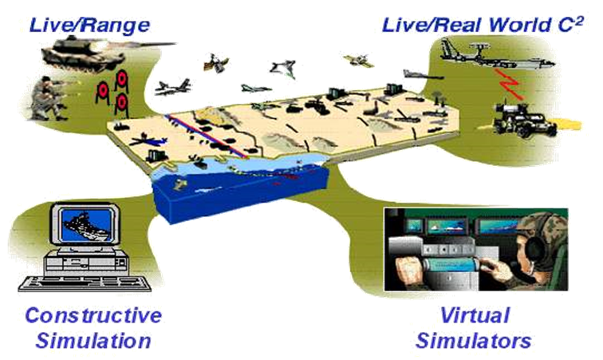
DND/CAF
Modelling and Simulation Coordination Office (MSCO)
Canadian Joint Warfare Centre (CJWC)
2025 JTLS-GO International Users Conference
Maj Pierre-Luc Gauthier
M&S Training Officer
Mr. Mike Lakatos
M&S Engineer
1

Slide 2
DND/CAF
Modelling and Simulation Coordination Office (MSCO)
Overview
2

Slide 3
DND/CAF M&S Policies
Defence Administrative Orders and Directives (DAOD) 2010-0 Modelling and Simulation
DAOD 2010-1 Modelling and Simulation Management
DND/CAF Capstone M&S Strategy Feb 2013
DND/CAF Capstone Roadmap Apr 2016
3
Notes:
DAOD 2010-0 Outlines the requirement for M&S in Defence
DAOD 2010-1 Outlines the Governance structure and base responsibilities
Strategy provided the Strategic goals for the Development of M&S as a capability in Defence.

Slide 4
Modelling and Simulation Coordination Office (MSCO)
MSCO falls under the Canadian Joint Operations Command (CJOC), within the Canadian Joint Warfare Centre (CJWC), but reports to the Vice Chief of Defence Staff (VCDS) from a Joint M&S Governance perspective
CJWC has evolved to become a key DND/CAF innovation centre for joint doctrine, lessons learned, capability development and collective training
Since its creation, the MSCO has demonstrated significant value and is uniquely positioned to effectively support both the Commander of Canadian Joint Operations Command, and Chief of Force Development with the use of M&S
4

Slide 5
Modelling and Simulation Coordination Office (MSCO)
Key benefits of M&S
Improved support to Operational Readiness
General efficiencies resulting in resources savings
Reduced risk to personnel, material, schedule and systems
Decreased environmental impact of DND/CAF operational activities
Increased quality and frequency of training at lower cost
Improved ways and means of developing the force
Enhanced individual and organisational learning and performance
  Striking the right balance in supporting both joint and collective training and longer-term capability development
5

Slide 6

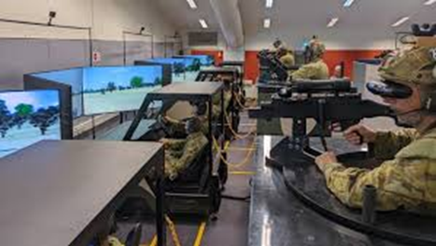
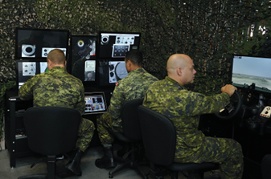

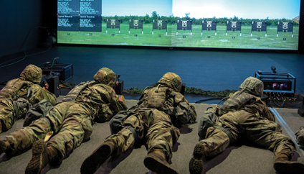

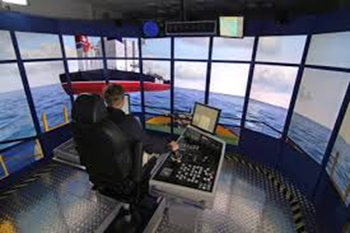

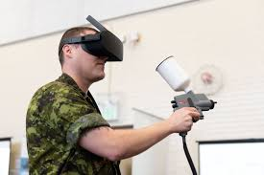
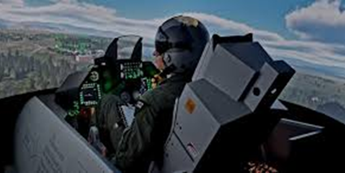
JOINT INTEGRATION
CAPABILITY DEVELOPMENT
OPERATIONAL SUPPORT
MISSION REHEARSAL
CONCEPT ANALYSIS
COALITION INTEGRATION
CAF MSCO
Modelling and Simulation Coordination Office (MSCO)
SERVICE LEVEL
COLLECTIVE TRAINING
RCAF CA RCN
INDIVIDUAL TRAINING
TECHNICAL TRAINING
RCAF CA RCN
6

Slide 7
MSCO Main Tasks
CAF Joint Simulation Authority
Develop and maintain DND/CAF M&S Strategy and Roadmap
Develop a Distributed, Enterprise level Joint M&S Capability
Provide Guidance for Cooperative and Coordinated activities
  Department of National Defence / Canadian Armed Forces
  Partner Organizations: Warfare Centers, Defence R&D Canada, Defence Acquisition
Provide Education and Training for DND/CAF
7
Notes:
7

Slide 8
MSCO Main Tasks
Establish DND/CAF M&S Standards and Best Practices
  Focus Areas
    Verification, Validation and Acceptance (VV&A)
    Cooperation with:
      Canadian Community of Practice
      NATO, Allies & partners, TTCP
      Simulation Interoperability Standards Organization (SISO)
Chair and management of the Synthetic Environment Working Group (SEWG) - DND/CAF stakeholder working group
  Land Forces, Maritime, Air and CJOC MSCOs
  Materiel, Science and Technology stakeholders
  Military and Civilian Subject Matter Experts (SMEs)
  Academia and other interested stakeholders
8

Slide 9
Level of M&S Support, Knowledge and Understanding
Establishing integrated M&S capabilities and an effective governance structure.
Detailed needs and requirements analysis.
Technology development
Initial acquisition and implementation activities complete.
Majority of capabilities provided
DND/CAF
M&S Roadmap
Institutionalized M&S capabilities as integral DND/CAF enablers.
Continued R&D into M&S.
Maturing M&S workforce.
Agile M&S Capabilities.
Institutionalize the new Governance Structure.
Incrementally invest in the Core Synthetic Environment.
Integrate the delivery of M&S.
Grow the M&S workforce.
M&S Capability, Investment and Maturity
Enable the Capstone M&S Strategy & Institutionalize M&S Req’ts thru Developing & Implementing the Keystone M&S Roadmap
Near Term
0 - 2 Years
Medium Term
2 - 5 Years
Long Term
5 -10 Years
9

Slide 10
Strategic Goal
Implementing a Joint and Integrated M&S
Governance Structure
Previously, Command level leadership of M&S initiatives and capability within DND/CAF has been addressed independently by each EC and Group Principal through its M&S Authority. The result of this has created “stove piped” systems, duplication of efforts, and inadequate M&S standardization and interoperability across DND/CAF.
Impact
The impact of effective M&S governance structures will ensure Joint, coordinated, integrated and shared M&S resources in support of all Joint M&S application areas, and a governance vehicle that can address common M&S requirements across DND/CAF.
Image taken from the approved
DND/CAF M&S Roadmap
10

Slide 11
DND/CAF
Modelling and Simulation Coordination Office (MSCO)
Where we are today
11

Slide 12
MSCO Ongoing activities
  Re-build ongoing of the simulation capabilities at CJWC to support L1 organisations (i.e. CJOC, CFD, Cyber Command, 3 Cdn Space Division)
  Staffing review and increase to support all MSCO taskings
  Continued collaboration with FVEY and NATO M&S Joint level partners
  Continued participation at NATO NMSG
  Review and refresh strategic documents
  Partnered with CFD to acquire JTLS-GO in FY 24/25 to support their CDTIP Future Force (FF) Wargame series
12

Slide 13
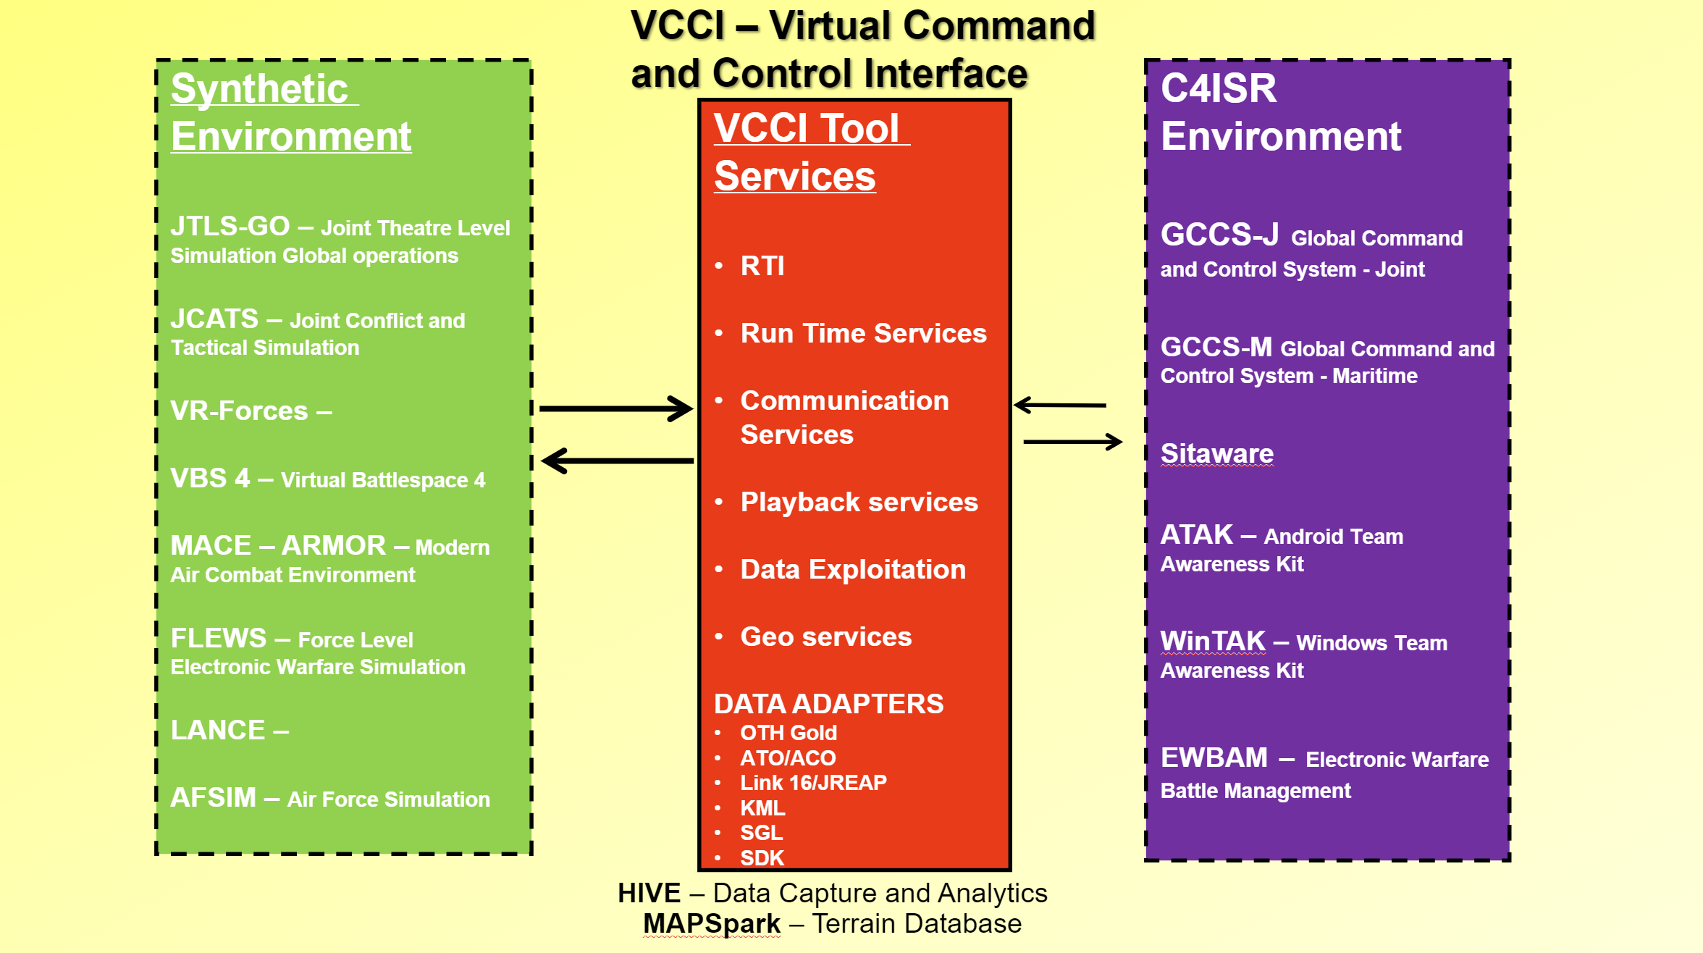










Modelling and Simulation as a Service – VCCI Architecture
FVEY
TTCP
VIPRE
L1 Organisations
CJOC
CFD
Cyber Command
3 CSD
CCSI
CFXNet
ORANGE
LVL II
NATO VIVA
NATO
MSCOE
JWC
JFTC
US JS J7
JTEN
JTSE
CFXNet – GREY UNCLASS
RAWC
DSSTNi
CFMWC
DMOC
CASC
VTEN
13
Notes:
The future architecture will move much of the infrastructure into the cloud. This will enable a much easier way to compose M&S events.

Slide 14



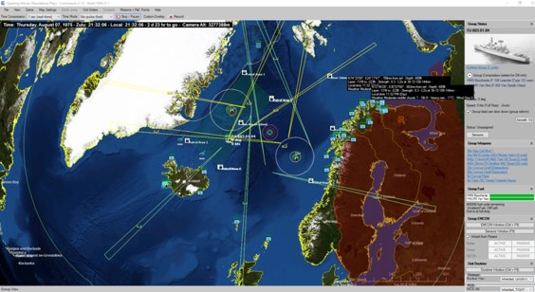
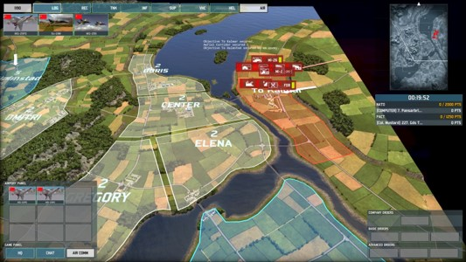
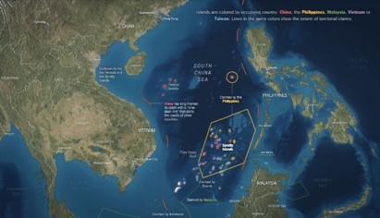



Future Op support and Concepts Development
14

Slide 15
As of:
Long term initiatives
  Established Tiger Teams with a Service Lead to support Training and Education for M&S across the CAF
  Standards and standardised practices for the use of M&S in DND/CAF
  Rewrite of the DAODs, Capstone Strategy and Roadmap with a sign off in 2025
  Establish a persistent CFXNet CAF enclave
  Continued Cooperation with Allies & partners
15
Notes:
CMSSP – Canadian Modelling and Simulation Standards Profile Document.

Slide 16


MSCO Engagements
Internal DND/CAF
SEWG (Synthetic Environment Working Group) (L1s)
CFD
CASC
CADTC
RAWC
CFMWC DMOC
Technology/Capability Development
SISO – Simulation Interoperability Standards Organisation
I/ITSEC – International/Industry Simulation Education Conference
ITEC – International Training and Education Conference
DSET – Defence Simulation Education and Training
CAX Forum – Computer Assisted Exercise Forum
JTSE/JLVC – US JS J7 Joint Training Synthetic Environment/ Joint Live Virtual Constructive
BQ Bold Quest
DATE – Decisive Action Training Environment
JTSE/JLVC US JS J7 Joint Training Synthetic Environment / Joint Live Virtual Constructive
TTCP – M&S MDO – FVEY Technical Cooperation Agreement
JEMSO – Joint Electro Magnetic Spectrum Operations
CAST MOU – Command and Staff Training MOU
CWIX – Coalition Warrior Interoperability Exercise/Experiment
NMSG – NATO M&S Group
NATO M&S Centre of Excellence
NATO Joint Warfare Centre
NATO Joint Force Training Centre
16

Slide 17
DND/CAF
Modelling and Simulation Coordination Office (MSCO)
Questions?
17

