Slide 1
U.S. ARMY COMBAT CAPABILITIES
DEVELOPMENT COMMAND
AVIATION & MISSILE CENTER
JSIL ENTERPRISE TEAM / MUSE AFSERS CAPABILITIES
14 april 2025

Slide 2
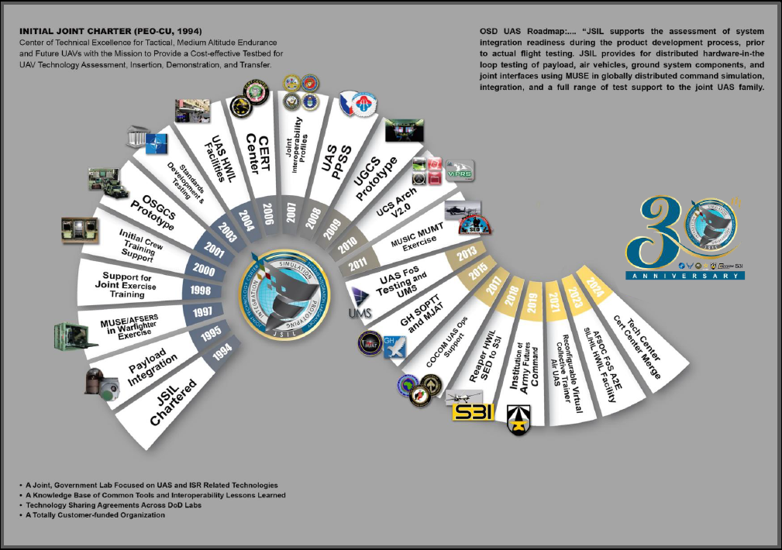
Jsil history

Slide 3
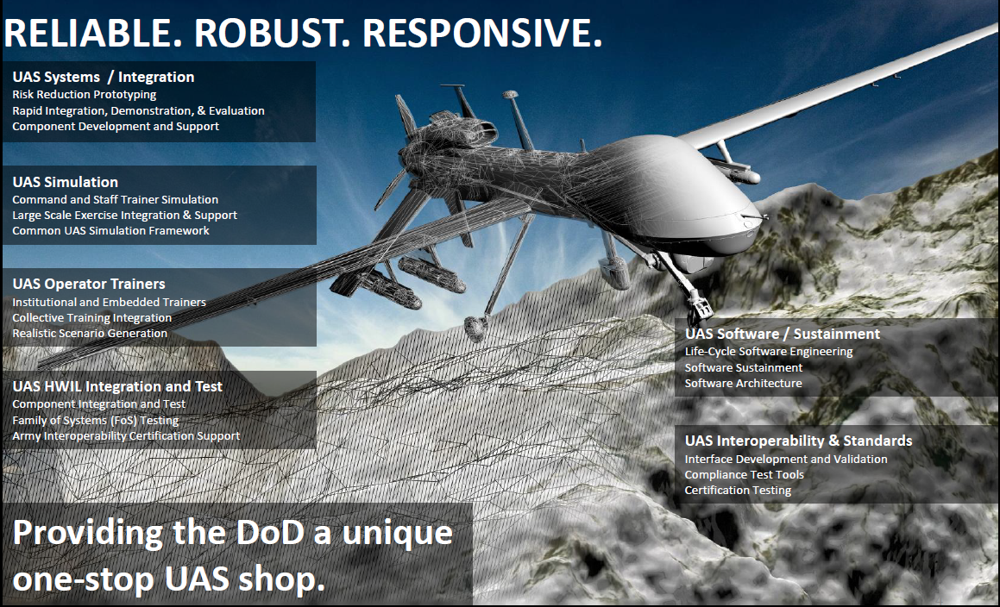

Slide 4
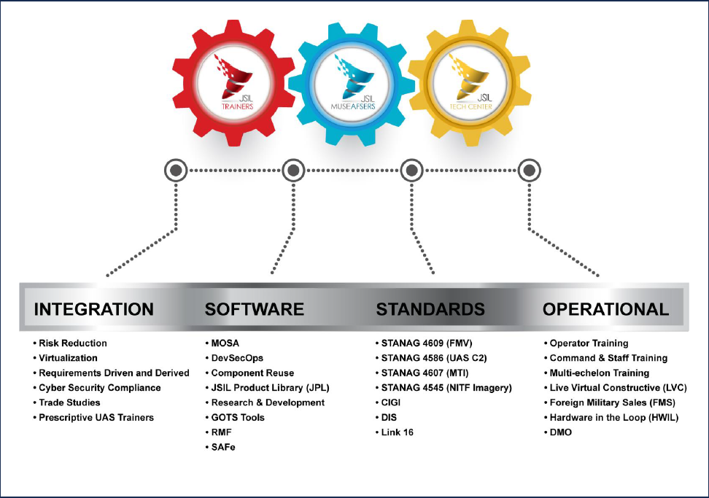

Slide 5
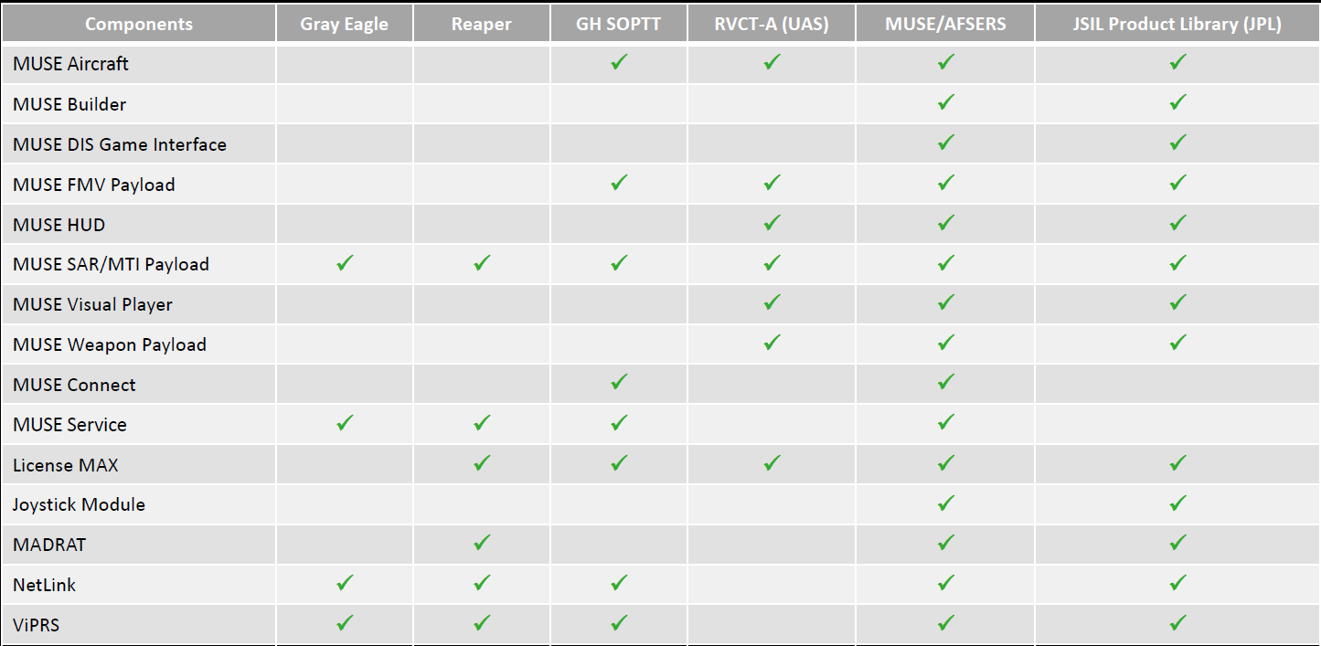
Jet Shared Library Suites

Slide 6

MUSE AFSERS
ARMY
Multiple Unified Simulation Environment
AIR FORCE
Air Force Synthetic Environment for Reconnaissance & Surveilence
Primary virtual Intelligence, Surveillance and Reconnaissance (ISR) and Unmanned Aircraft Systems (UAS) simulation used within the Department of Defense (DoD) for command and staff level training for the Joint Services and component commands

Slide 7
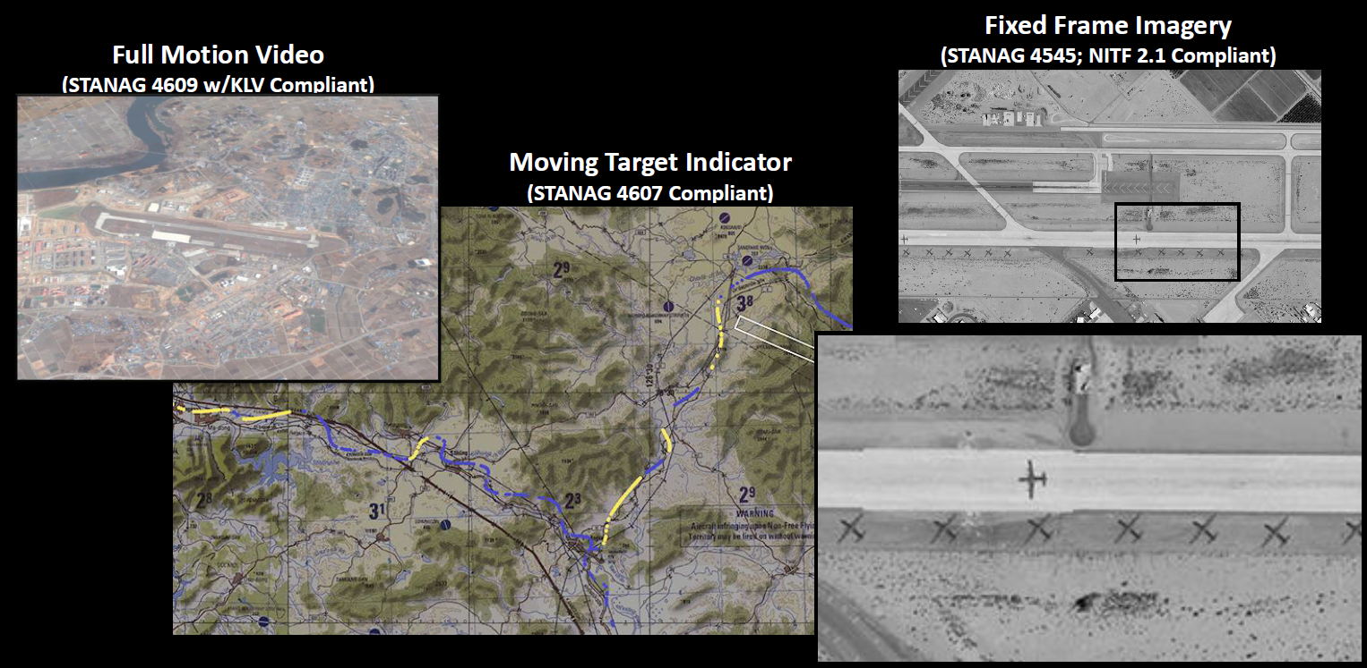
MUSE AFSERS CAPABILITIES

Slide 8
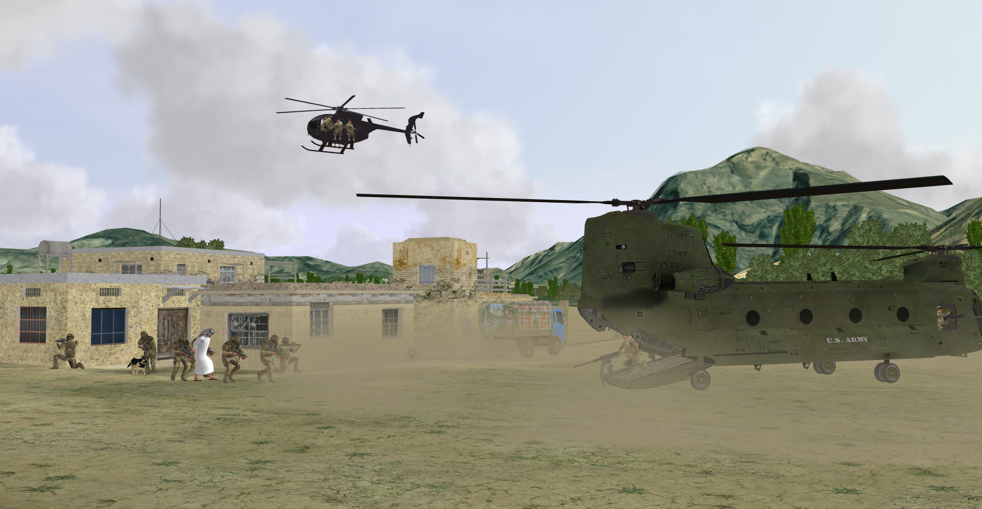
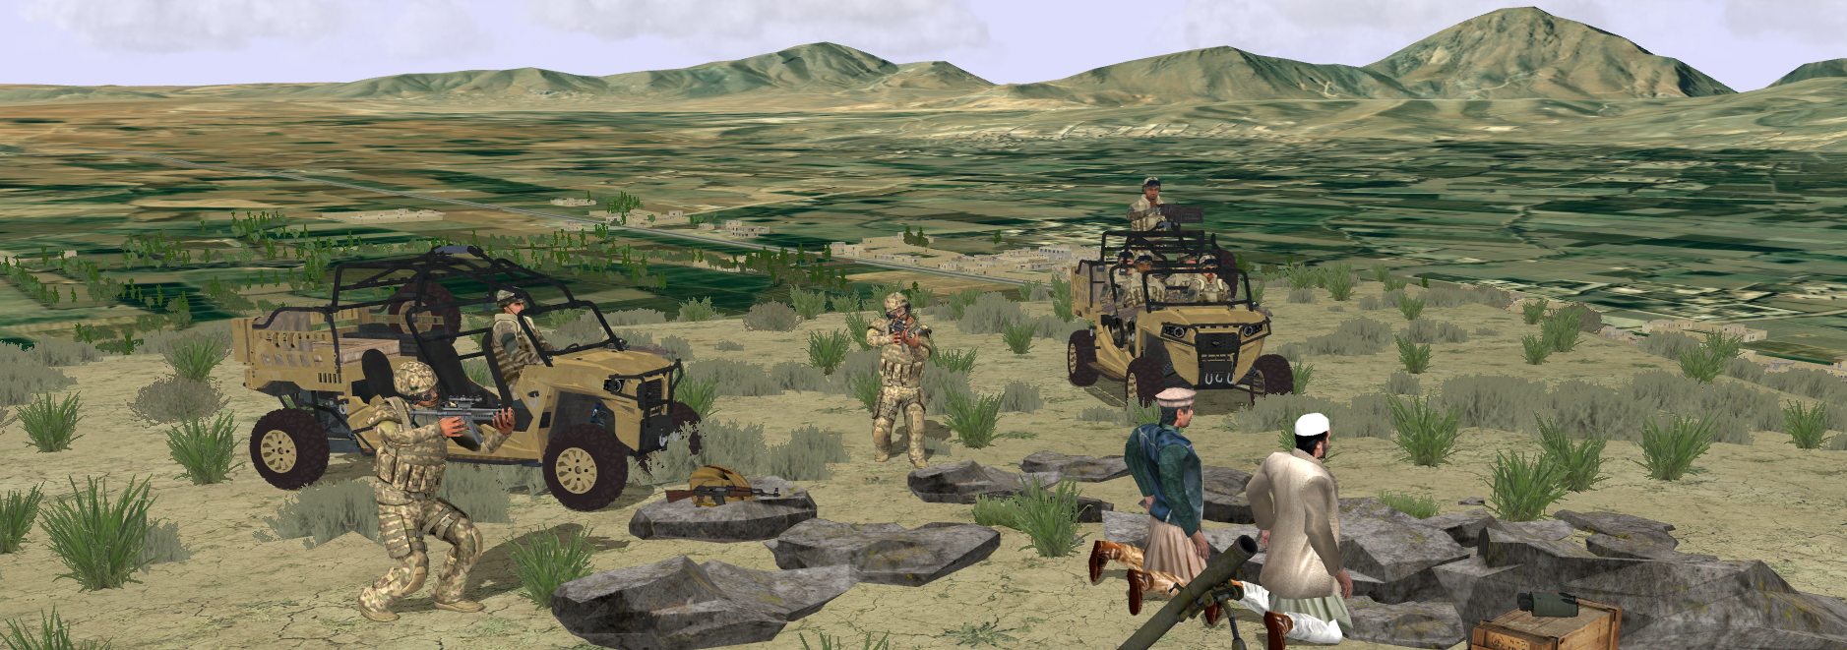
Vignette Planning and Rehearsal Software (ViPRS)
  ViPRS is a training and development tool used for building, editing and playing back deterministic scenarios called ‘Vignettes’.
  Users can navigate a 3D interactive environment either with a DIS Simulation System like AFSERS or as a standalone editor, using animated characters, equipment, waypoints, and events that compose their Vignettes.
  ViPRS can integrate with any DIS
  compliant federation or trainer and
  you can build or edit your vignettes
  in real time.
  ViPRS Scenarios are scalable from
  1 to ~ 10,000 entities (HW dependent)

Slide 9
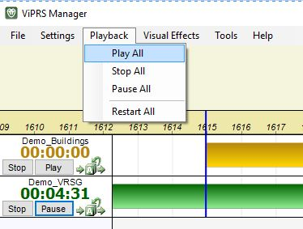
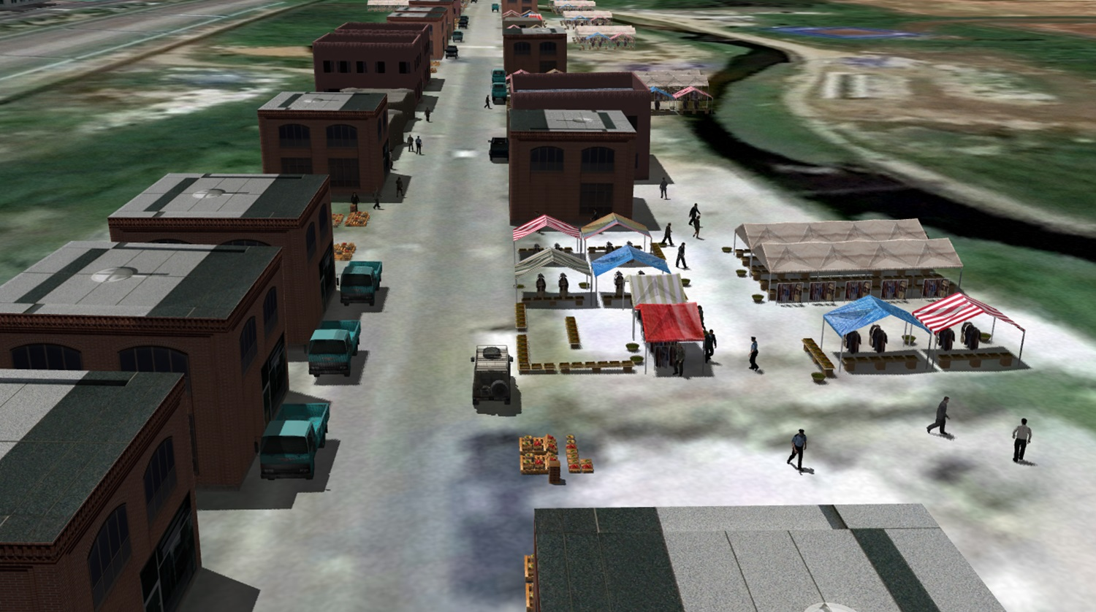
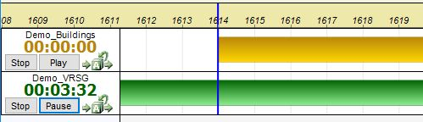
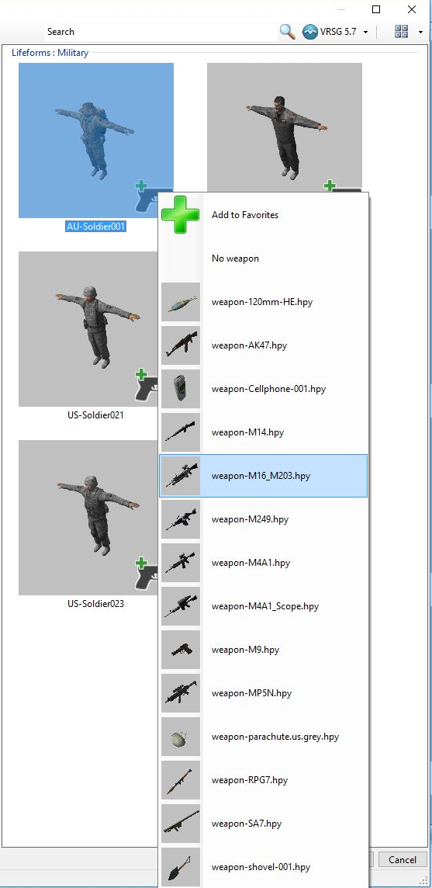
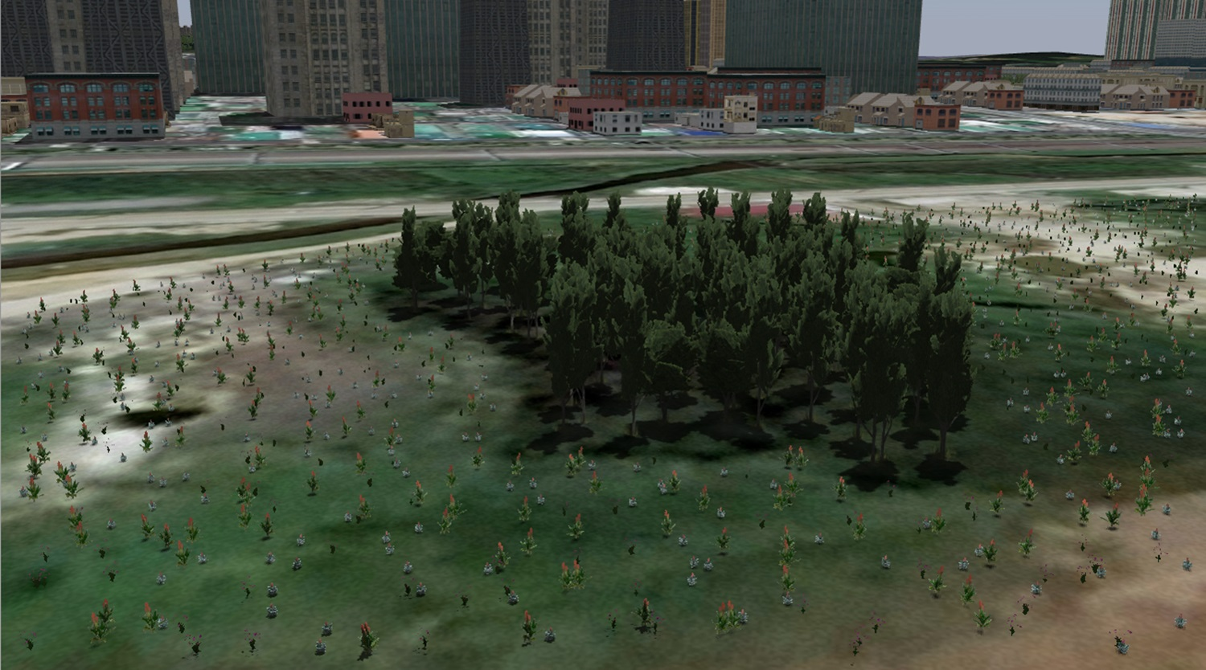
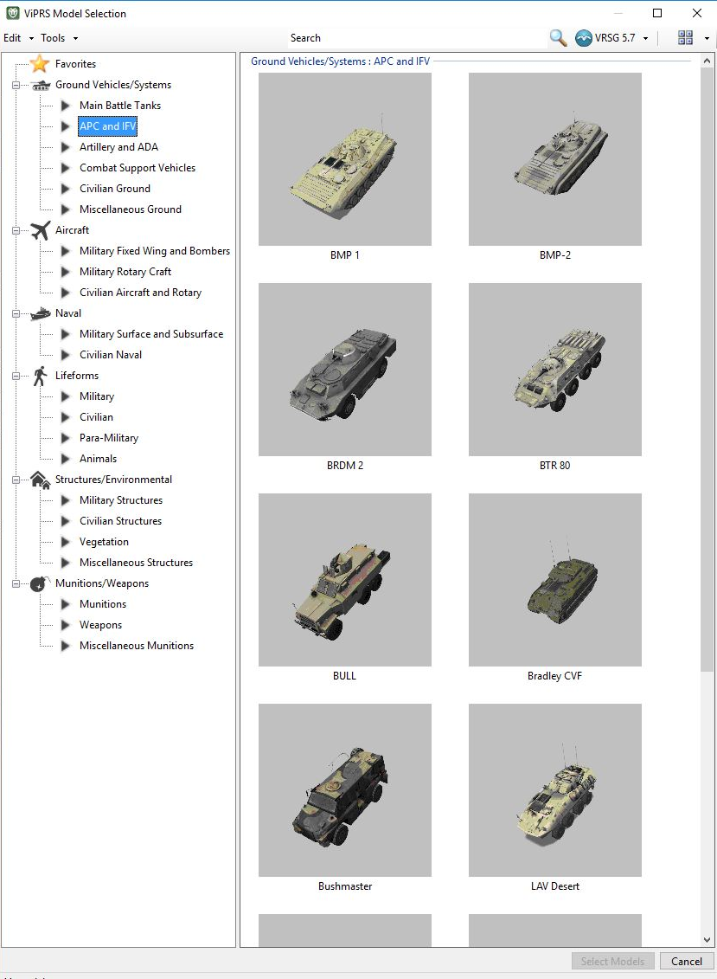
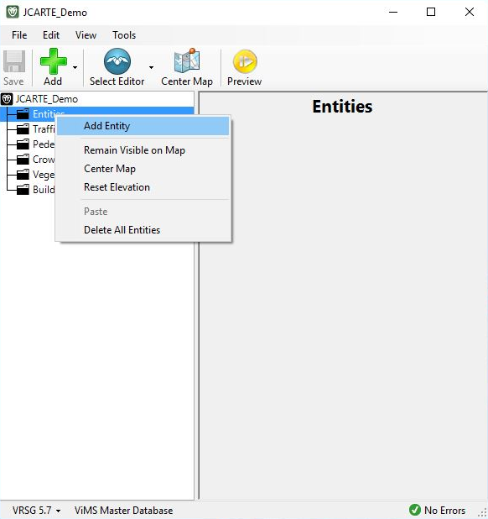
Scenario Development with ViPRS

Slide 10
ViPRS (cont)
Ease of Use – Users can flesh out a scenario with lots of moving content using Crowds, Vehicle Traffic and Pedestrian Routes
Deterministic – Scenarios play out the same way giving a uniform training experience every time
DIS Compliant – Entities makes ViPRS IG and integration agnostic
Content – Representative of thousands of pieces of equipment which you can animate and manipulate including military, civilian, NGO, even infrastructure objects
Supports grouping objects, vegetation, clusters, Copy/Paste, and Templates
Produce Cultural files from Vignettes

Slide 11
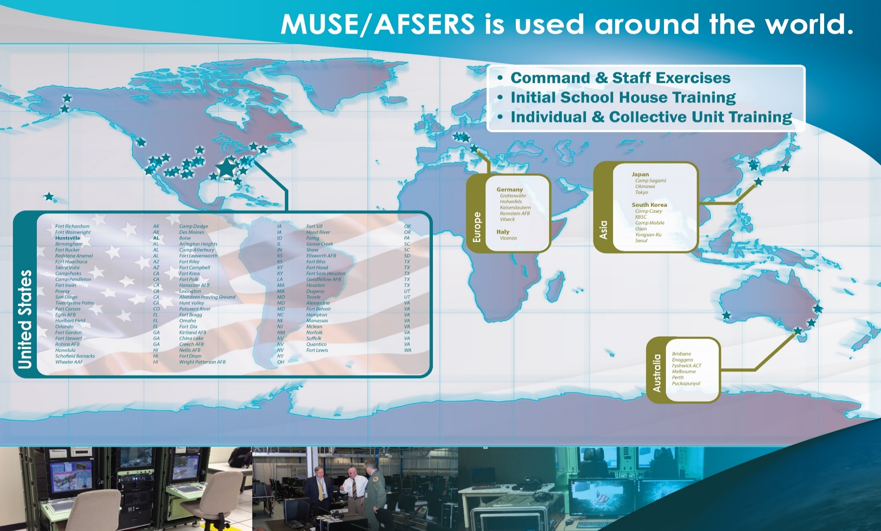

Slide 12
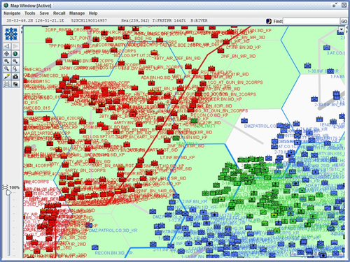
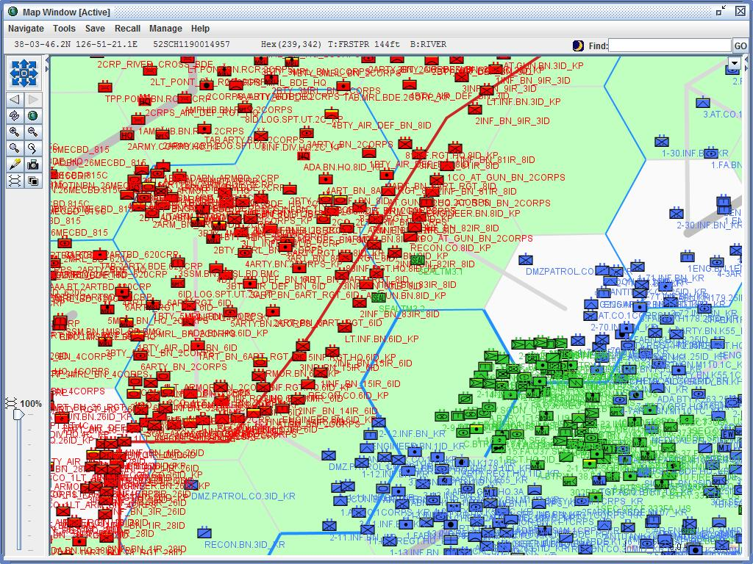
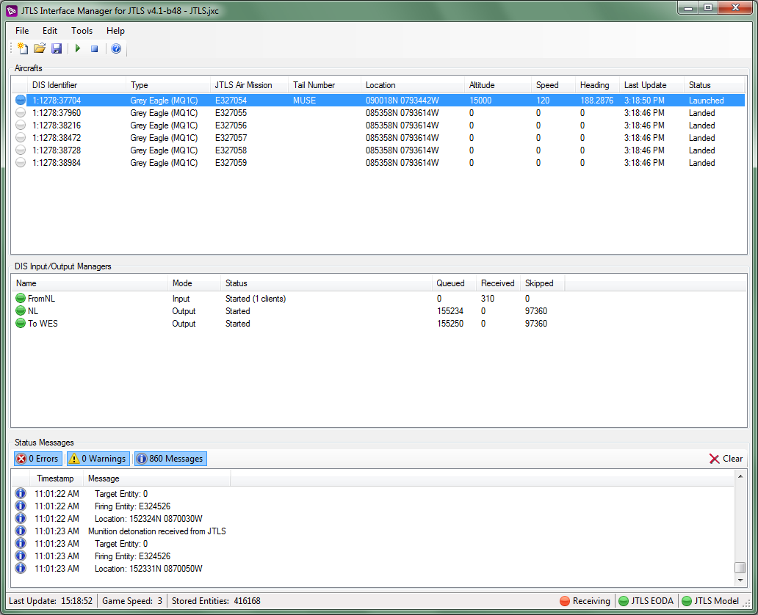
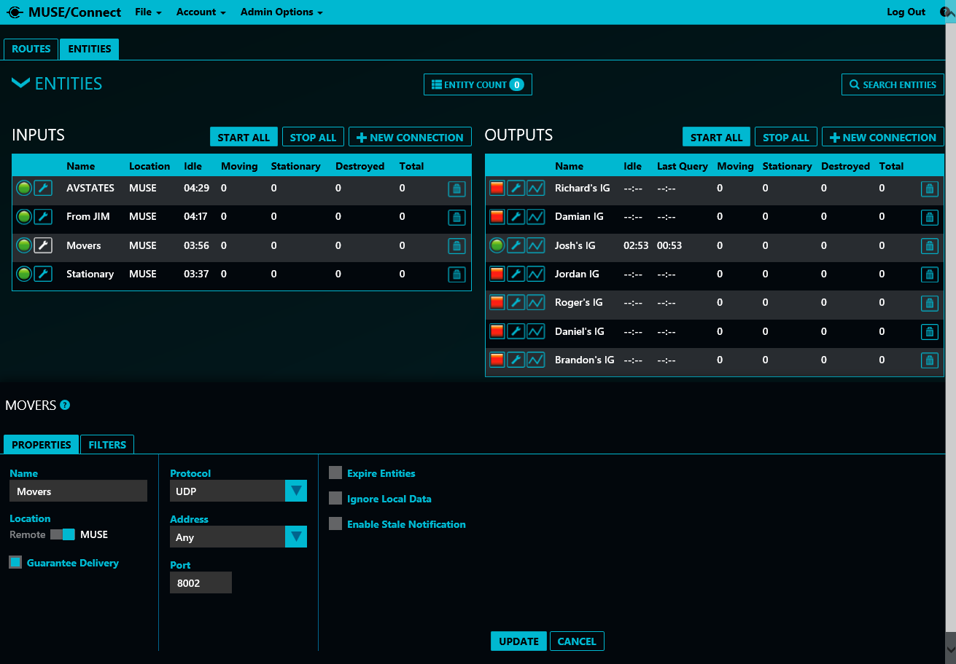
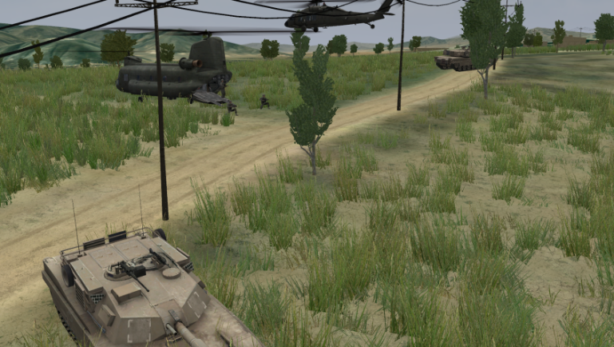
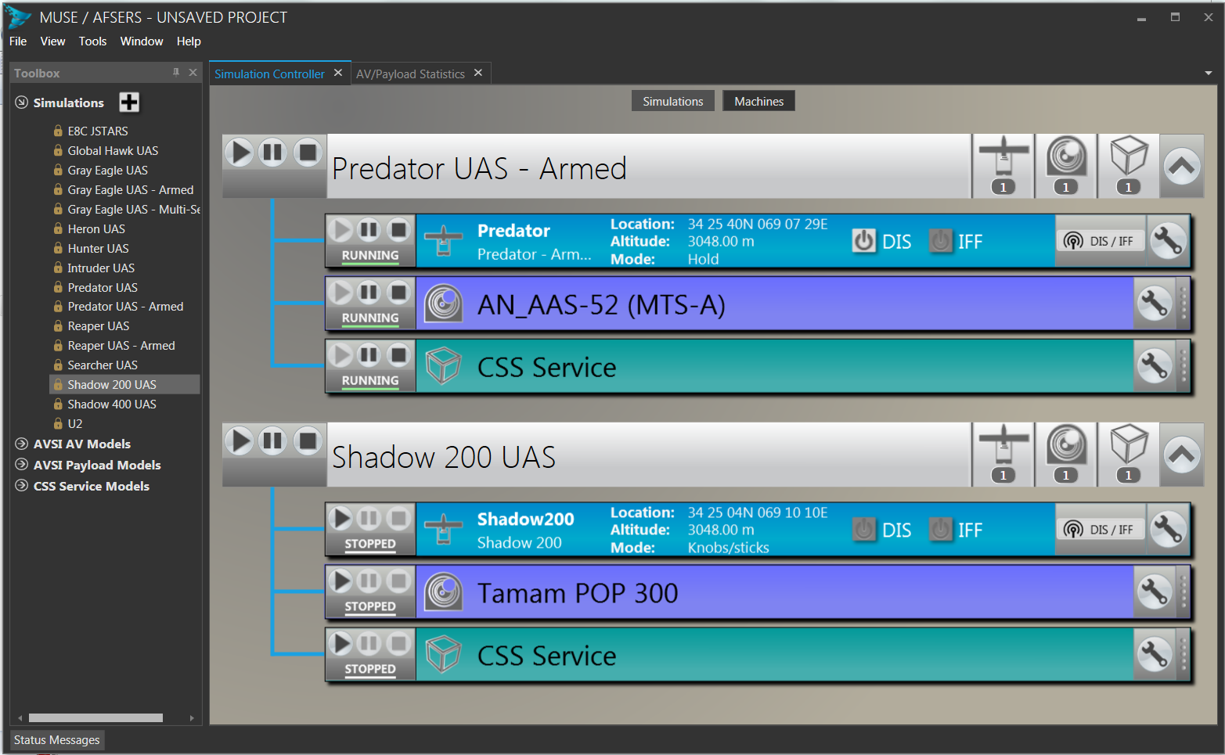
JTLS – MUSE/AFSERS INTEGRATION
Translates JTLS to TCP DIS
TCP
TCP
Up to 9 Million Entities
Fully Interactive
No HLA
BDA
MUSE Connect
Sends only entities
near the aircraft
MUSE Aircraft
UDP
UDP

Slide 13
Jtls models for sending data to muse
All JTLS Game Data - Send all JTLS Game Data to the JIM
Geographic – Send only JTLS Game Data within a defined geographic area
UAV Aware – Send only JTLS Game Data of units within a defined radius around launched UAVs.

Slide 14
Muse connect modes for sending data to dis network
All Game Data - Send all entities to the DIS network
Geographic – Send only entities within a defined geographic area
UAV Aware – Send only entities within a defined radius around a UAV.

Slide 15
JSIL 3D Model/Terrain Library
The JSIL 3D Model and Terrain team hosts a library of thousands of 3D models compatible with VRSG, NVIG, and Rocket IG as well as Terrain Databases representing hundreds of thousands of square miles of coverage area all over the world and can build new databases with the most up to date imagery and 3D models representing real cultural details on demand.
CONTENT UPDATED AND RELEASED CONTINUOUSLY
  Thousands of 3D models available
    .hpx, .flt, fbx
  Vast library of available terrain
  Correlated databases for multiple IG’s
    VRSG, NVIG
  AAA quality gaming content
    High resolution textures
    High polygon meshes
  Decoupled content delivery from AFSERS
  Faster delivery than with AFSERS
  Accessible on demand to M&S community
  Linked on MUSE/AFSERS’s Milgaming page
  https://milgaming.army.mil/Entrance/Product.aspx?pid=55

Slide 16
JSIL 3D Model/Terrain Library
The JSIL (Joint Simulation Integration Laboratory) 3D Model and Terrain database Team mission is to provide virtual warfighter training content by developing realistic high-resolution terrain databases in conjunction with multi-functional, high-fidelity 3D model content that accurately represent real world locations and supports the most realistic training of real capabilities.
Future Capabilities
    Full integration with Rocket IG
    Extruded building geometry from OSM data
    Material encoded terrain from OSM data
    Material Encoded Terrain at pixel level
    Material Encoded 3D models
    Geometry from Textures
    More realistic model geometry
      Model Articulations through ViPRS
      Physics simulated kinetic deformations
    Unreal 5 3D model Library
      New UE5 Human Character Models
      New UE5 Human Animations
  Linked on MUSE/AFSERS’s Milgaming page
  https://milgaming.army.mil/Entrance/Product.aspx?pid=55

Slide 17
JSIL 3D Model/Terrain Library

Slide 18
JSIL 3D Model/Terrain Library

Slide 19
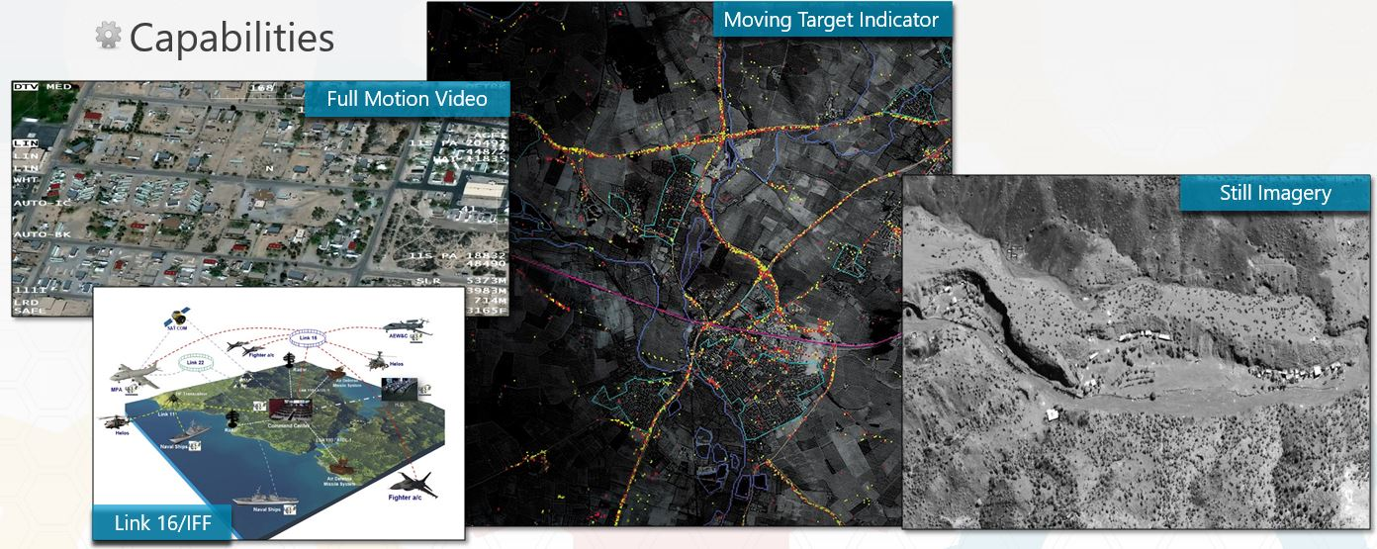
Exercise and test events
Training Topics
a. Installation and "Clean uninstall"
b. MUSE License, how to get a new one and where it goes
c. Troubleshooting topics throughout all topics (common hardware and software)
d. New features in 11.4
e. Addressed common issues run across within JTLS and MUSE
f. Connect (connecting to BE server/ACE-IOS and other configurations/filters, ROI for FMV/FFI/MTI, creating groups)
g. Netlink (test patterns/PCAP)
h. FMV
i. Streaming video
j. Smartbook
k. Builder
l. FFI
m. MTI (w/MOVINT)
n. ATOMM (importing ATO/ACO files, exporting airspaces, setting filters)
o. MMT and ModelMap
p. MADRAT
q. Mission Controller (DIS Viewer, MTI Viewer, Shape files, Maps/DTED, configuring and importing collection decks, etc)
r. MUSE Client (changes, saving project files, etc.)
s. Setting up a command station/center collaboration
t. NIC configuration utility
Services Provided
Trained
  Payload Operators
  Image Analysts to do PED (Processing Exploitation & Dissemination)
Capabilities provided
  FMV (Full Motion Video)
    MQ-9 Reaper
    MQ-1C Gray Eagle
  MTI (Moving Target Indicator)
    RQ-4 Global Hawk
    E8-C Jointstars
  FFI (Fixed Frame Imagery)
    U2 Dragon Lady
Software Testing & Validation
  JTLS Federation

Slide 20
Muse/afsers 11.4
Added a new Weapon and Swarms Player (WaSP)
  Supports GPS and laser guided munitions
  Supports Launched Effects (LE)
New Joystick control
    Configurable function mappings
    Press & hold or press once lasing capability
Enhanced MTI support:
  Simultaneous support for FMV and MTI sensors
  New DIS Vehicle Adapter (DVA) attachment for MTI sensors
Improved the ViPRS “Favorites” functionality
Added new PDU support for MADRAT
Improved filtering support in NetLink

Slide 21
Muse/afsers 12.x (Future)
National satellite EO/IR support
DVA support for WaSP
New desktop version of Connect
Joystick control for the AV
Support for Modular SAR Payload for AV and Satellite
  Improved EO/IR Imagery
  Lo-Fi SAR
Further Rocket IG integration

Slide 22

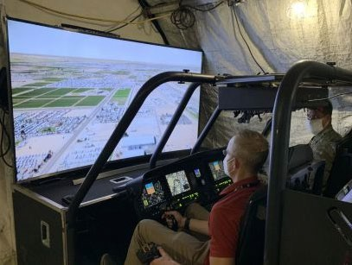
Rocket Image Generator
What is Image Generator (IG) Software? It’s software to provide out-the-window or sensor visuals of the 3D virtual environment for simulations (i.e. flight simulator)
Goal: Rocket IG will be a common, modern, accessible, sustainable, government image generator shared across multiple programs.
Objectives:
Government controlled and managed
Leverages leading commercial game technology
  State-of-the-art graphics and rendering capability
  Rapidly tailored and scaled
STE and OWT compatible
  Runtime environment
  Correlated terrain library
Open standards (interoperability)
  Data segregation (runtime - 3D models, terrain, etc.)
  Integration with existing authoritative data models
Accessible
  download, install, setup, operate
Collaborations and partnerships
  Cross agency, service, allies
RocketIG running on CAP-T EVSC rotary-wing aviation platform

Slide 23
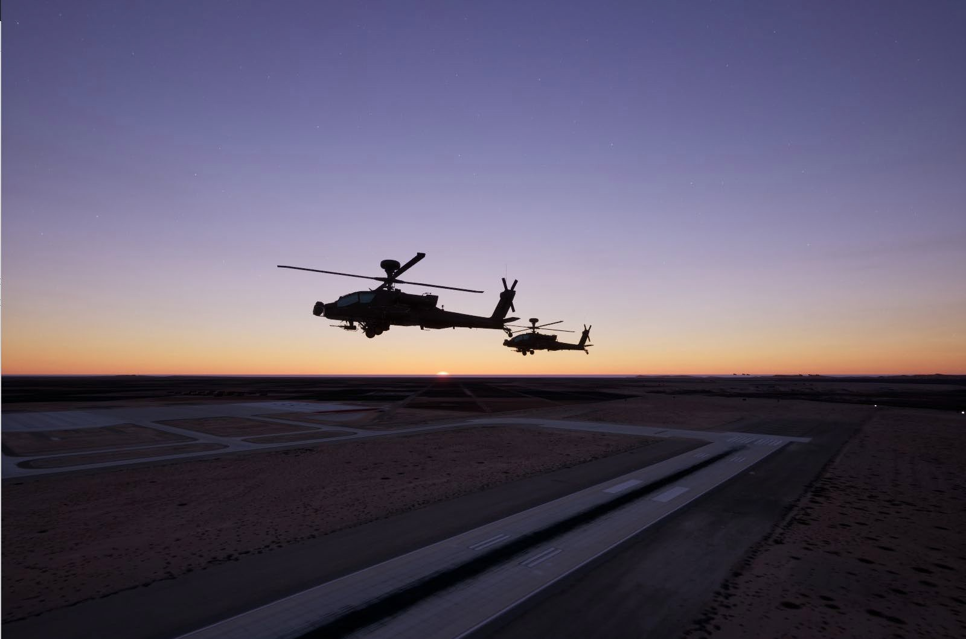
Rocket Image Generator
Image Generation for Live, Virtual, Constructive and Gaming
Government Solution – Goal: “The easy button”
Open Licensing Strategy (Fully GOTS solution)
Industry Standards (CIGI 3.3/4.0, DIS 6.0, STANAG 4609)
Authoritative data (IR, SAR)
Segregated Data (Terrain, models, plugins, etc.)
Quality Solution (AAA content)
Latest Technologies
Open Commercial Systems
  Unreal 5.X (Nanite, Lumen, Niagara)
  FBX/glTF 2.0 models and animations
“From Space to the Soldier, RocketIG is ready for training and visualization at all levels.”

Slide 24

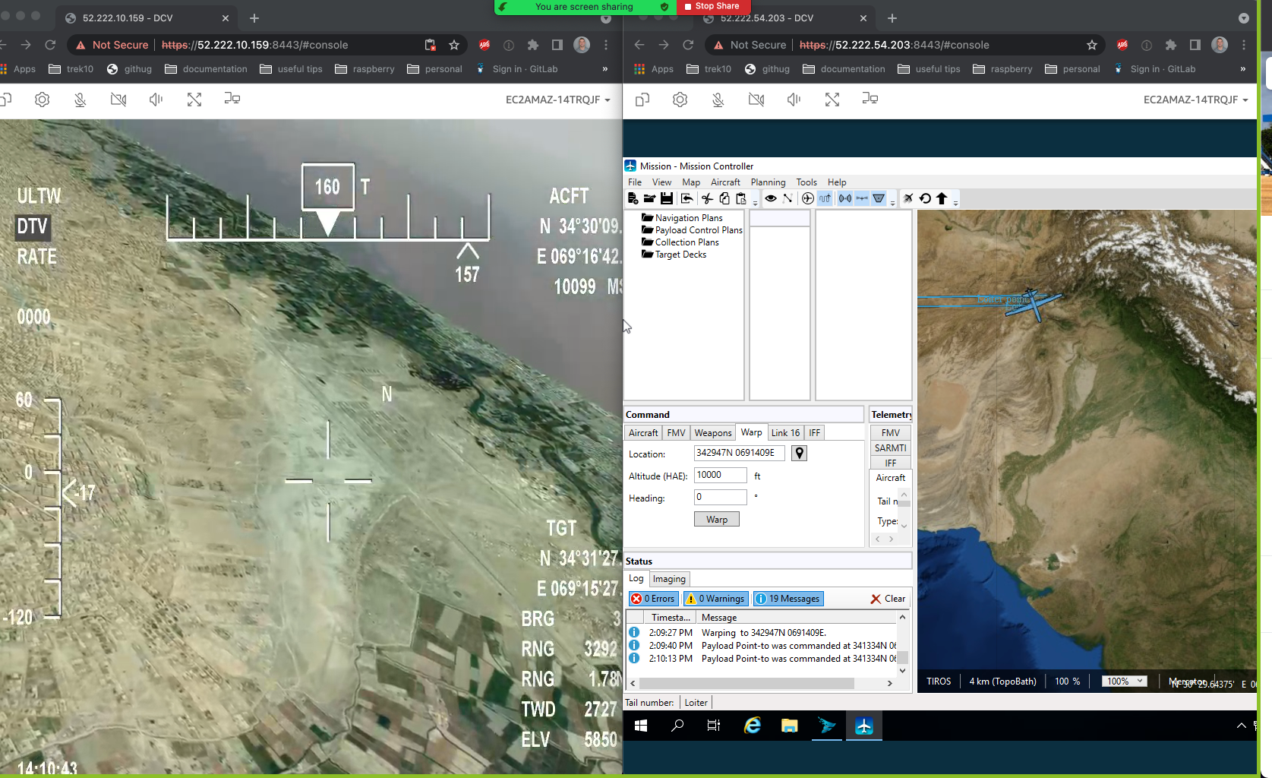


MUSE/AFSERS in the Cloud
AF Phase III SBIR
Easily scale number and size of hosting nodes
Launch additional training infrastructure and platforms with a few clicks
Centralizes components like terrain data for use across multiple systems
Supports up to 60 frames per second
Full joystick compatibility
Administrative Webapp
Support training from anywhere in the world

